Slide 1
Price the Product
Chapter Nine

Slide 2
Chapter Objectives
Explain the importance of pricing, the process of making pricing decisions, and how marketers set objectives for their pricing strategies
Describe how marketers use costs, demands, revenue, and the pricing environment to make pricing decisions
Understand key pricing strategies
Understand pricing tactics and how to set price points
Understand the opportunities for Internet pricing strategies
Describe the legal and ethical aspects of pricing
Copyright © 2013 Pearson Canada Inc.
9-<number>
Notes:
p. 296
LECTURE NOTES:
By the end of this chapter, you should be able to:
Explain the importance of pricing, the process of making pricing decisions, and how marketers set objectives for their pricing strategies
Describe how marketers use costs, demands, revenue, and the pricing environment to make pricing decisions
Understand key pricing strategies
Understand pricing tactics and how to set price points
Understand the opportunities for Internet pricing strategies
Describe the legal and ethical aspects of pricing

Slide 3
I. Explain the importance of pricing, the process of making pricing decisions, and how marketers set objectives for their pricing strategies
Copyright © 2013 Pearson Canada Inc.
9-<number>
Notes:
This slide relates to Learning Objective (hereafter LO) #1 of chapter 9.

Slide 4
“Yes, But What Does It Cost?”
Price
    The value that consumers give up, or exchange to obtain a desired product
    Payment may include money, goods, services, favours, votes, or anything else that has value to the other party
    Nonmonetary costs involve
      Psychological costs
      Operating costs
      Switching costs
      Opportunity costs
      Risks
Copyright © 2013 Pearson Canada Inc.
9-<number>
Notes:
This slide relates to LO #1 of chapter 9.
p. 296 - 297
LECTURE NOTES:
When you think of price, you probably think of the amount of money you have to pay to purchase a product or enjoy a service. Price certainly includes the cost of an item, but it also includes other things that must be exchanged as part of a transaction. For example, many international business transactions are characterized by various forms of barter or countertrade that don’t involve an exchange of money at all. Even in Canada, the purchase of a car may include trade-in of your existing vehicle along with a cash payment.
Opportunity costs refer to the something that we have to give up in order to obtain something else. For example, think about the “price” that must be paid by an individual for a two week-long vacation at an all-inclusive resort. What else must the individual give up besides the monetary cost of the vacation?

Slide 5
The Importance of Pricing Decisions
Good pricing decisions are critical to a firm’s success
For most organizations, the only source of profit is through the price charged for products
Price is the most important consideration for most consumers when making a purchase or deciding where to shop
Internet price comparison sites and price comparison functionality are becoming increasingly popular
Copyright © 2013 Pearson Canada Inc.
9-<number>
Notes:
This slide relates to LO #1 of chapter 9.
p. 297 – 298

Slide 6
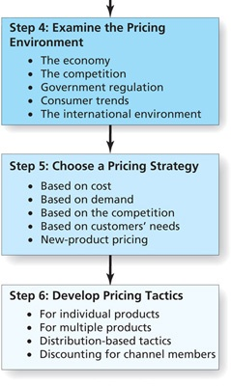
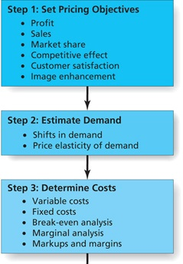
Figure 9.2
Process of Price Planning
Copyright © 2013 Pearson Canada Inc.
9-<number>
Notes:
This slide relates to LO #1 of chapter 9.
p. 299
LECTURE NOTES:
Firms undertake price planning in six steps, as shown in Figure 9.2. The process begins by setting objectives. This is followed by estimating demand and determining relevant costs. Examination of the pricing environment precedes the choice of a pricing strategy and the implementation of pricing tactics. Each of these steps will be discussed in more detail as we work through the chapter material.

Slide 7
Step 1: Develop Pricing Objectives
The first crucial step in price planning is to develop different types of pricing objectives
Profit objectives
Sales or market share objectives
Competitive effect objectives
Customer satisfaction objectives
Image enhancement objectives
Pricing objectives should be flexible
Copyright © 2013 Pearson Canada Inc.
9-<number>
Notes:
This slide relates to LO #1 of chapter 9.
p. 299 – 302

Slide 8
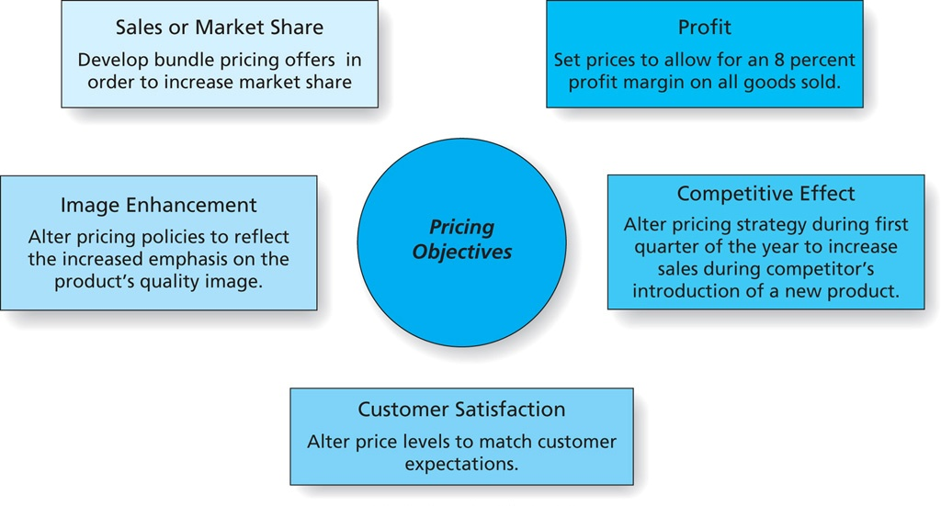
Figure 9.3
Pricing Objectives
Copyright © 2013 Pearson Canada Inc.
9-<number>
Notes:
qw31qqqqThis slide relates to LO #1 of chapter 9.
p. 300
LECTURE NOTES:
Pricing objectives take five major forms: sales or market share, profit, image enhancement, competitive effect, or customer satisfaction. Examples of each strategy are summarized in Figure 9.3
Profit objectives are typically used in the pricing of B2B goods. For consumer goods firms, profit objectives may focus on a product line or portfolio of products.
Profit objectives are crucial for fad products, because fads tend to be short-lived. However, sometimes sales objectives are set for fad products instead. For example, who knew that Pepsi marketed a drink called Ice Cucumber soda? The drink wasn’t available in the United States, but 4.8 million bottles were sold within a two-week time span in Japan. Once the existing inventory was depleted, the product was killed—on purpose— having met it sales objectives. Most students will be surprised to hear this, especially because product development took over two years to complete. Yet this is but one example of a systematic strategy on Pepsi’s part to raise their overall share of the market by playing to cultural differences related to a love of fads. In particular, the Japanese are intrigued by limited edition or fad items, and flock to the stores when new limited edition items become available. Pepsi’s strategy has paid off. According to Business Week, their share of the Japanese beverage market increased from 10% in the late 1990’s to around 20% in August of 2007, while chief rival Coca-Cola’s market share has been declining over the same time period.
{SOURCE: “Fad Marketing’s Balancing Act,” Business Week Online, August 6, 2007. Retrieved from http://www.businessweek.com/magazine/content/07_32/b4045055.htm on March 27, 2012.}
When pricing objectives feature sales or market share, marketers often use sales promotions or pricing discounts to meet these objectives. Such strategies must be approached with caution however, as the case of the U.S. airline industry illustrates.
However, if a product has a competitive advantage it may well be able to accomplish market share or sales objectives without resorting to the use of discounts or sales promotions.
Sometimes the firm consciously prices its products in a way that negatively impacts competitors’ marketing efforts. Established brands often react to new market entrants by cutting prices (sometimes even below the cost of the product or service) in an attempt to drive the newcomer out of business or out of the geographic market. Small business marketers often do the same thing.
Marketers must be very, very careful when implementing such a strategy as predatory pricing practices may be viewed by a given country as anti-competitive, and thus illegal. We will discuss predatory pricing in more detail later on in the chapter.
Many quality-focused firms believe that profit stems from customer satisfaction, so some firms price their products in a manner that satisfies customers. This philosophy was behind Saturn’s no haggle pricing strategy, as then parent company GM recognized that many car buyers are dissatisfied with or even intimidated by the negotiation process that accompanies car buying.
Consumers who lack experience in buying a certain type of product (such as carpet for example) and who are unfamiliar with brand names within a product category will often rely on price as a cue to product quality. Brands that are marketed on the basis of status or prestige should correspondingly charge higher prices to reflect that image to consumers.

Slide 9
II. Describe how marketers use costs, demands, revenue, and the pricing environment to make pricing decisions
Copyright © 2013 Pearson Canada Inc.
9-<number>
Notes:
This slide relates to LO #2 of chapter 9.

Slide 10
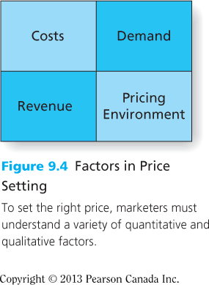
Figure 9.4
Factors in Price Setting
Copyright © 2013 Pearson Canada Inc.
9-<number>
Notes:
This slide relates to LO #2 of chapter 9.
p. 302
LECTURE NOTES:
Once objectives are set, marketers begin the actual process of setting the price of a brand. This requires estimations of demand, costs, revenues, and an understanding of the pricing environment.

Slide 11
Step 2: Estimate Demand and Value
The second step in price planning is to estimate demand and perceived value
Understand demand curve (see Figure 9.5)
    For normal products and prestige products
Understand shifts in demand (see Figure 9.6)
    Upward and downward shift
Estimate demand (see Table 9.1)
Understand price elasticity of demand (see Table 9.7)
Copyright © 2013 Pearson Canada Inc.
9-<number>
Notes:
This slide relates to LO #2 of chapter 9.
p. 302 - 304
LECTURE NOTES:
The second step of the pricing process is to estimate demand, or the level of consumer desire for a product. Marketers need to understand the relationship between demand and price, and how much of a product customers are willing to buy as its price goes up or down.

Slide 12
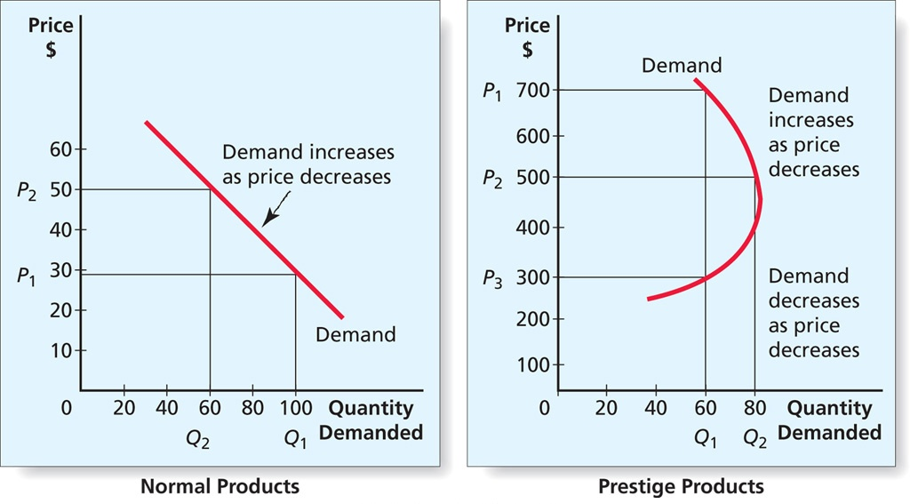
Figure 9.5
Demand Curves for Normal and Prestige Products
Copyright © 2013 Pearson Canada Inc.
9-<number>
Notes:
This slide relates to LO #2 of chapter 9.
p. 303
LECTURE NOTES:
Demand curves illustrate the effect of price on quantity demanded. For normal products, the demand curve isn’t a curve at all, but rather it is just a straight line, as shown here for normal products. In this situation, the law of demand dictates that as price goes up, quantity demanded declines.
The vertical axis of demand curves shows the various prices that a firm might be willing to charge for a product. Demand is portrayed as the number of units that consumers are willing to purchase at a given price. Thus when price is set at $30 (P1), the quantity demanded is forecast to be 100 units (Q1) while a price increase to $50 (P2) results in a drop of demand to 60 units (Q2).
However, the law of demand does not always accurately reflect how price and demand interact. For example, brands that are marketed on the basis of prestige, status or simple snob appeal are characterized by a very different sort of demand curve, as shown on the right-hand side of Figure 9.5.
In this situation, the low price makes the product undesirable as consumers simply can’t reconcile a low cost with a prestigious product. They may suspect the brand is a counterfeit, for example. As the price increases so does demand, to a certain point. Some consumers feel that a product becomes more desirable as the price increases simply because not everyone can afford to buy it.
However, as the price continues to increase, some buyers will drop out of the market.
The combination of these factors creates the backward facing demand curve shown for Prestige Products in Figure 9.5.
For prestige products, a price increase may actually increase the quantity demanded.

Slide 13
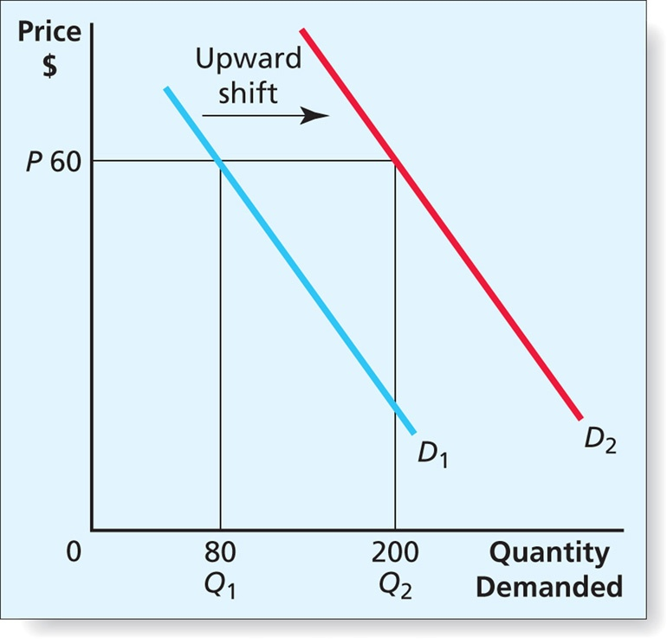
Figure 9.6
Shift in Demand Curve
Copyright © 2013 Pearson Canada Inc.
9-<number>
Notes:
This slide relates to LO #2 of chapter 9.
p. 304
LECTURE NOTES:
Typical demand curves assume that only price changes, but in reality, other factors can change and shift demand upward or downward.
For example, changes in marketing strategy such as the addition of a new, highly desired product feature or the launch of a fantastic new advertising campaign can shift the demand curve upward (to the right), meaning that MORE units are now demanded at a given price compared to before the change in marketing strategy was implemented.
Correspondingly, a variety of things can cause a downward shift in demand. Product recalls can stifle demand, development of new technologies can make a product’s existing technology obsolete and thus less desirable, a scandal in the parent company may stir up negative sentiment against the firm and brand, etc.
Weather can even influence demand for everything from umbrellas and sweatshirts to hotel accommodations and movie tickets.

Slide 14
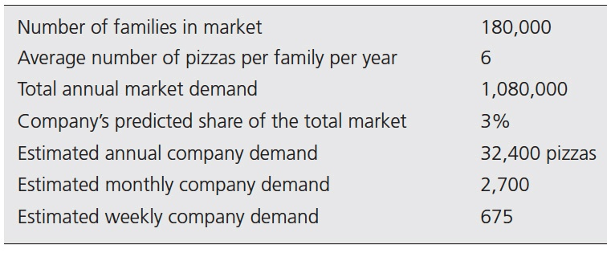
Table 9.1
Estimating Demand for Pizza
Copyright © 2013 Pearson Canada Inc.
9-<number>
Notes:
This slide relates to LO #2 of chapter 9.
p. 305
LECTURE NOTES:
Estimating demand accurately is critical as demand estimates influence production scheduling, marketing planning, budgeting and more.
Table 9.1 illustrates the demand estimation process in the context of how a new business such as a pizza parlour might estimate demand for the market it expects to serve.
The process begins by identifying the number of potential buyers of the product, and multiplying that number by the average number of purchases each buyer is likely to make over a particular time period. In this example, the geographic area being served by the pizza firm contained 180,000 pizza eating families who on average ordered out or dined in at pizza parlours six times a year. Multiplying these two factors yielded a total annual market demand of 1,080,000 pizzas.
The next step to estimating company demand is to multiply the total annual demand by the firm or brand’s forecast market share. Thus 3% of the total market yields an estimated annual company demand of 32,400 pizzas, which divided by 12 and 52, yields monthly and weekly pizza demands of 2700 and 675, respectively.
While this process may sound simple, marketers must be realistic at each phase of the demand estimation process. For example, using census data to project the number of families in the market would overestimate demand, as not all families eat pizza. Similarly, failing to take into account current economic conditions could cause inaccurate projections. When the economy is in a recession families may eat out less frequently or choose to buy grocery store pizzas instead. Furthermore, the level of competition and consumer trends can also influence the accuracy of demand estimates.
What other factors might cause monthly or weekly demand levels to vary?
DISCUSSION NOTE:
Marketers may need to adjust monthly or weekly demand levels when certain factors have a direct or indirect influence on demand levels. Some factors to consider include the impact of special events (e.g., “back to school”; “Black Friday”, the day after Thanksgiving; January inventory clearance sales), and holidays (Christmas, Fourth of July). Many other factors can complicate demand calculations, including seasonal influences, whether the product in question is a durable good (such as a lawn mower), or a non-durable good (such as pizza), and the region of the country for which the forecast is being made.

Slide 15
Price Elasticity of Demand
Percentage change in quantity demanded
Price elasticity of demand = Percentage change in price
Cross-elasticity of demand
    Changes in the price of one product affect the demand for another item
    When products are substitutes, an increase in the price of one increases demand for the other
    When products are complements, an increase in the price of one decreases demand for another
Copyright © 2013 Pearson Canada Inc.
9-<number>
Notes:
This slide relates to LO #2 of chapter 9.
p. 304 - 306
LECTURE NOTES:
The essence of cross-elasticity of demand is that when products are substitutes for one another, a price increase in one will be reflected as an increase in price for the other.
However when products are complements, meaning that one product is essential to the use of the first, an increase in the price of one will decrease demand for another.
A couple of specific examples are shown below:
Brand Name vs. Store Brand
Increasing the price of Diet Dr. Pepper to $5.99 a 12-pack from $4.99 could easily increase demand for Diet Dr. Thunder (currently selling for over $2.00 less per 12-pack in the PPT author’s market).
Delivery methods
Increasing the price of pay-per-view movies available via cable could increase demand for NetFlix (movie rental by mail or download).

Slide 16
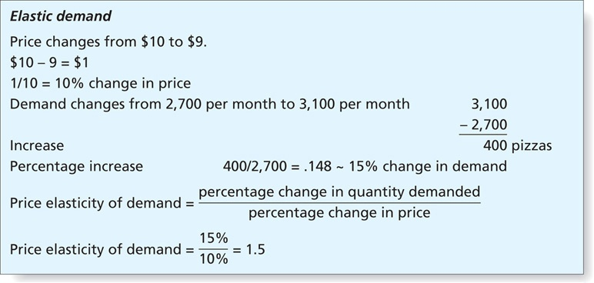
Figure 9.7
Price Elasticity of Demand
Copyright © 2013 Pearson Canada Inc.
9-<number>
Notes:
This slide relates to LO #2 of chapter 9.
p. 306
LECTURE NOTES:
Figure 9.7 presents an example of elastic demand and how the price elasticity of demand can be calculated.
In this example, a price decrease in the cost of pizza is being considered. A dollar drop in price, a 10% decrease, results in a 15% increase in unit sales.
The price elasticity of demand is calculated by dividing the percentage of change in the quantity demanded by the percentage change in price. If the resulting number is greater than ONE, demand is ELASTIC. If the resulting figure is equal to or less than one, demand is INELASTIC.

Slide 17
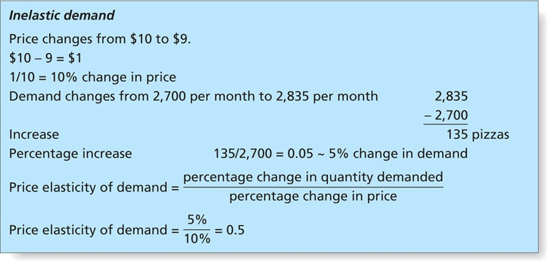
Figure 9.7 (ctn’d)
Price Elasticity of Demand
Copyright © 2013 Pearson Canada Inc.
9-<number>
Notes:
This slide relates to LO #2 of chapter 9.
p. 306
LECTURE NOTES:
By contrast, Figure 9.7 presents an example of inelastic demand and how the price elasticity of demand can be calculated.
A price decrease is also being considered. This 10% decrease in price resulted in a 5% increase in unit sales.
The price elasticity of demand is calculated by dividing the two percentages as shown, and since the resulting calculation of 0.5 is less than one, it means that demand is inelastic.
The examples shown here and on the previous slide show the elasticity of demand at a given price point. It is important to remember that the elasticity for the SAME product often differs at different price levels. Thus before considering any type of pricing change, marketers must test the elasticity of demand for the specific price points being considered.

Slide 18
It’s Debatable
Class Discussion Question
What factors influence the price elasticity of demand?
How would you classify the following in terms of price elasticity?
Gasoline Air travel
Movie tickets Baby diapers
What alternatives to a price increase might marketers of an elastic product consider? : Reducing the quantity of the product and leave price the same
Copyright © 2013 Pearson Canada Inc.
9-<number>
Notes:
This slide relates to LO #2 of chapter 9.
DISCUSSION NOTES:
Factors that influence the elasticity of demand include whether or not the product is considered by consumers to be a necessity, and the degree to which close substitutes are available.
For example, non-necessities such as pizza generate elastic demand. If the local pizza place raises its prices, students can buy frozen pizza from the store or they could choose to eat elsewhere, such as at a Mexican fast food restaurant or burger joint.
By contrast, the demand for necessities such as electricity is generally inelastic.
Answers will vary with regard to the second question.
Certainly there will always be a portion of people who view gasoline or air travel as a necessity for commuting to work or otherwise conducting business, but a large proportion of demand is elastic. Thus when prices get TOO high, people stop taking joy rides, using their boats, jet skis, and 4 wheelers, and may begin carpooling to work or school.
On the other hand, baby diapers are likely to be price inelastic because they are viewed as necessities by new parents.
Marketers of products that are highly price elastic often disguise price increases by leaving the price of the product the same, but reducing the quantity or size of the product provided. Thus the consumer ends up paying more per ounce, for example, due to the smaller quantity.
Another method of disguising a price increase is to eliminate something from the product that was previously included with prior versions. For example, when the market for printers became more price competitive AND price elastic, manufacturers stopped including cables, and full capacity ink cartridges (instead opting for smaller capacity cartridges that were used up very quickly).

Slide 19
Step 3: Determine Costs
The third step in price planning is to determine costs
Understand variable and fixed costs (see Figure 9.8)
Understand break-even analysis (see Figure 9.9)
Understand marginal analysis (see Figure 9.10)
Copyright © 2013 Pearson Canada Inc.
9-<number>
Notes:
This slide relates to LO #2 of chapter 9.
p. 307 - 312
LECTURE NOTES:
The second step of the pricing process is to estimate demand, or the level of consumer desire for a product. Marketers need to understand the relationship between demand and price, and how much of a product customers are willing to buy as its price goes up or down.

Slide 20
Variable and Fixed Costs
Variable costs
    The costs of production that are tied to and vary, depending on the number of units produced
Fixed costs
    Costs of production that do not change with the number of units produced
Total costs
    The total of the fixed costs and the variable costs for a set number of units produced
Copyright © 2013 Pearson Canada Inc.
9-<number>
Notes:
This slide relates to LO #2 of chapter 9.
p. 307 - 308

Slide 21
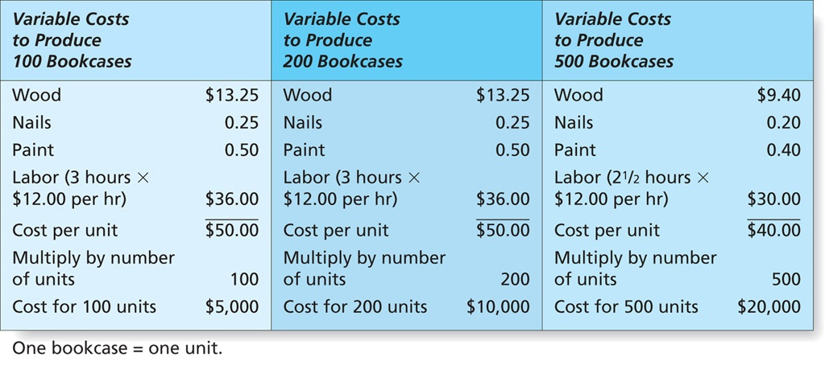
Figure 9.8
Variable Costs at Different Levels of Production
Copyright © 2013 Pearson Canada Inc.
9-<number>
Notes:
This slide relates to LO #2 of chapter 9.
p. 307
LECTURE NOTES:
The third step of the pricing process requires that the marketer be certain that the products price will cover costs. For this to happen, marketers must estimate variable and fixed costs.
Variable costs are those production costs that are tied to the number of units produced and thus vary depending on volume. As the example shown here illustrates, materials such as wood, nails, and paint that are used to produce a product are considered variable costs, as are the hourly labour costs associated with the production process.
Figure 9.8 shows how the average variable costs per unit may change as the number of products produced changes. The higher the production level, the more likely it is that the manufacturer will be able to negotiate a better deal for materials due to the larger quantities being purchased.
Fixed costs don’t change with the number of units produced, whether it’s 100 or 10,000. Thus the average fixed cost per unit will always decrease as the number of units produced increases.
Fixed costs include the costs of renting or owning production facilities, the cost of utilities to heat or cool the factor, the cost of equipment used in the production process, etc. Other fixed costs include salaries of administrative personnel (basically anyone who is not directly involved in manufacturing the product). Short-term advertising and marketing expenses are also considered to be fixed costs as well.
Total costs are simply the combined fixed and variable costs at a given production level.

Slide 22
Break-Even Analysis
Break-even analysis
    A method for determining the number of units that a firm must produce and sell at a given price to cover all its costs
Break-even point
    The point at which the total revenue and total costs are equal and beyond which the company makes a profit; below that point, the firm will suffer a loss
Contribution per unit
    The difference between the price the firm charges for a product and the variable costs
Copyright © 2013 Pearson Canada Inc.
9-<number>
Notes:
This slide relates to LO #2 of chapter 9.
p. 308 - 309

Slide 23
Break-Even Analysis (ctn’d)
total fixed costs
Break-even point (units) =
contribution per unit to fixed costs
total fixed costs
Break-even point ($) =
variable cost per unit 1 −
price
(
)
Copyright © 2013 Pearson Canada Inc.
9-<number>
Notes:
This slide relates to LO #2 of chapter 9.
p. 309
LECTURE NOTES:
Determining break-even involves several calculations. The first thing a firm needs to do is to calculate the contribution per unit by subtracting the variable cost per unit from the selling price.
In the previous example, total variable costs were $50 per unit, which when subtracted from the $100 selling price, left a contribution margin to fixed costs of $50 per unit.
Total fixed costs were $200,000. When divided by $50, the break-even point of 4,000 is reached.
To calculate the break-even point in dollars, a similar procedure is followed. The variable cost per unit of $50 divided by the $100 selling price equals 0.5. When the total fixed costs of $200,000 are divided by 0.5, the $400,000 break-even point in dollars is reached.
Finally, it is also worth mentioning that some firms will set a profit goal to the break-even formula by adding a dollar amount representing profit to the total fixed costs. The revised formulas can then be used to determine how many units must be sold to reach the desired profit level.

Slide 24
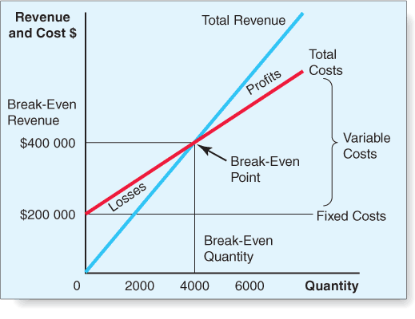
Figure 9.9 Break-Even Analysis
Copyright © 2013 Pearson Canada Inc.
9-<number>
Notes:
This slide relates to LO #2 of chapter 9.
p. 309
LECTURE NOTES:
Break-even analysis is a critical technique used by marketers to determine the number of units which must be sold at a given price to cover total costs.
As Figure 9.9 demonstrates, total revenue and total cost are equal at the break-even point. Assuming a price of $100, the manufacturer will reach the break-even point (in units) at 4,000, which, when multiplied by the $100 unit price, indicates a break-even point (in dollars) of $400,000.
Sales of more than 4,000 units will yield profits, while sales below the break-even point will lead to financial losses.

Slide 25
Marginal Analysis
Marginal analysis
    A method that uses cost and demand to identity the price that will maximize profits
Marginal cost
    The increase in total cost that results from producing one additional unit of a product
Marginal revenue
    The increase in total income or revenue that results from selling one additional unit of a product
Copyright © 2013 Pearson Canada Inc.
9-<number>
Notes:
This slide relates to LO #2 of chapter 9.
p. 310
LECTURE NOTES:
Marginal analysis allows marketers to look at cost and demand concurrently in order to find the price that will maximize profits.
The vertical axis in Figure 9.10 represent the cost and revenues in dollars, while the horizontal axis represents the quantity produced and sold. A couple of key terms need to be defined before we continue our discussion:
Marginal cost: Increase in total costs from producing one additional unit of a product.
Marginal revenue: Increase in total income or revenue from selling one additional unit (decreases with each additional unit sold).
Average revenue: Represents the demand curve, or the amount of product that people are willing to buy at a given price. Like marginal revenue, average revenue decreases with each unit sold.
Profit is maximized where marginal cost is exactly equal to marginal revenue. Beyond this point, the cost of producing an additional unit is MORE than the revenue that can be earned, and profit will decline.
While marginal analysis is viable in theory, it is not practical in the real-world. Production costs vary unexpectedly for a variety of reasons, and the actions of competitors or changes in the economy can impact consumer demand. Thus marginal analysis is rarely used as a practical technique in setting price.

Slide 26
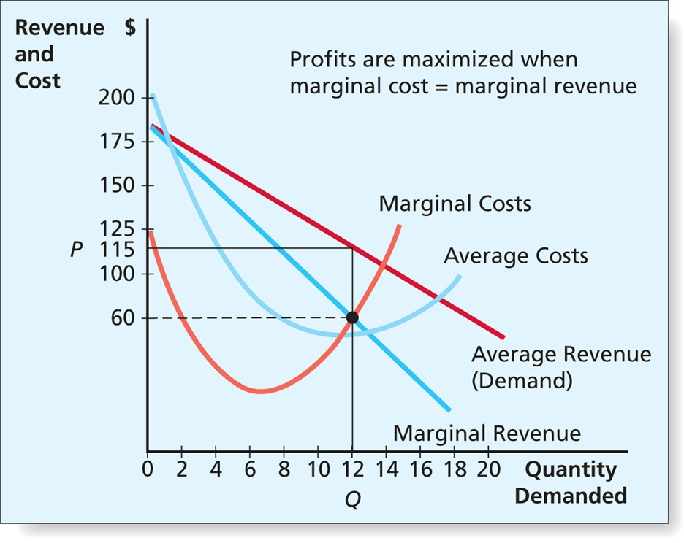
Figure 9.10
Marginal Analysis
Profit is maximized at the point at which marginal cost is equal to marginal revenue
Copyright © 2013 Pearson Canada Inc.
9-<number>
Notes:
This slide relates to LO #2 of chapter 9.
p. 311

Slide 27
Markups and Margins:
Pricing Through the Channel
Markup
An amount added to the cost of the product to create a price at which the channel member will sell the product
Gross margin
Retailer margin
Wholesaler margin
List price (manufacturer’s suggested retail price)
Copyright © 2013 Pearson Canada Inc.
9-<number>
Notes:
This slide relates to LO #2 of chapter 9.
p. 311 – 312
LECTURE NOTES:
Most products are not sold directly from the manufacturer to the consumer; thus channel pricing considerations are often part of the marketer’s job. Marketers must make certain that they price the product in way that will allow each member of the distribution channel to earn a profit before selling the product in turn to the next member of the distribution channel, or to the ultimate consumer. Of course, the final price to the ultimate consumer cannot be so high that they will refuse to purchase the product.
Several terms must be understood as each has a place in pricing the product. Markup is defined on the slide.
The markup amount is often called the gross margin, which not only covers the profit expected by the channel member, but also the fixed costs of the retailer or wholesaler. Retailer margin and wholesaler margin are just two different names for gross margin, but specific, as the names imply, to either retailers or wholesalers.
The markup should never exceed the list price, or manufacturer’s suggested retail price (MSRP), as this is the price the manufacturer has estimated that the end customer should be willing to pay.
This means that if the customer is willing to pay $10 for a product, the manufacturer must sell the product for less than this amount to the retailer. If a distributor or wholesaler is also used, the price charged by the manufacturer will be lower still to ensure that both the distributor and retailer can add adequate markups to make handling the product viable.
While markup can be calculated as a percentage of the final selling price, or as a percentage of the price paid for the product. For simplicity sake, let’s assume markup is calculated on the basis of final price>
$10 = final price to consumer. Retailer margin = 30%. 1 − 0.30 = 0.70 $10 x 0.70 = $7 price to retailer if manufacturer sells directly to them.
Assuming that a wholesaler is also in the picture, and that the wholesaler’s margin is 20%, 1 − 0.20 = 0.80 $7 x 0.80 = $5.40. Thus the manufacturer would price the product at $5.40 to the wholesaler.

Slide 28
Step 4: Examine the Pricing Environment
The fourth step in price planning is to examine the pricing environment
The economy
The competition
The government regulation
Consumer behaviour & trends
The international environment
Copyright © 2013 Pearson Canada Inc.
9-<number>
Notes:
This slide relates to LO #2 of chapter 9.
p. 312 - 316
LECTURE NOTES:
It’s essential that marketers also consider the firm’s external environment when they set prices.
Broad economic trends such as the business cycle, economic growth, inflation, and consumer confidence may help a firm determine which pricing strategy is most appropriate.
In particular though, marketers need to understand how price impacts consumers during a recession. Consumers’ tend to become very price-sensitive when economic conditions are bleak. For example, P&G suffered market share, sales, and profit declines in 2008 as consumers switched away from P&G’s premium priced brands to cheaper alternatives. P&G chose both price cutting and product enhancement strategies as a means of combating the recession. For example, they created a more absorbent Pampers diaper without increasing price.
Inflation, on the other hand, often allows marketers to increase prices because consumers have become accustomed to price increases. Unfortunately, during inflationary periods, consumers may also grow fearful about the future and cut back on purchases. If this happens, the marketers may actually lower prices and temporarily sacrifice profits to maintain sales.
Marketers also try to anticipate how the competition will react to pricing changes.
Pricing wars can be disastrous, so it’s not always smart to continually lower prices. During price wars, consumers’ perceptions of a “fair price” may change, leaving a target market who is unwilling to pay “normal” prices once the war is over.
The industry structure can influence pricing a great deal. Oligopolies, such as the airline industry, typically attempt to avoid price competition and are more likely to price similarly in order to remain profitable. Restaurants and other industries characterized by monopolistic competition vary their prices, and focus on nonprice competition as each sells at least a somewhat different product. This type of pricing strategy is aided by the fact that consumers are less likely to comparison shop as the offerings between different firms within an industry are usually different enough to make comparisons difficult. And of course, there is typically little opportunity to alter price in a purely competitive market such as is found with most agricultural products and commodities.
Government regulation impacts pricing in two ways. First, a number of regulations enforced at the federal and provincial levels increase the costs of production. Secondly, the government has the ability to freeze or regulate prices, including credit card fees, interest rate charges, etc.
Consumer cultural and demographic trends can strongly influence prices. One example is that even consumers who are well-off see nothing wrong with bargain-hunting, particularly in tough economic times.
A special economic consideration in international price setting is the exchange rate and exchange rate volatility. Changes in the exchange rate can substantially influence the profitability of a brand sold in a foreign market. Furthermore, the marketing environment varies widely between countries. Very often unique environmental factors force marketers to adapt their pricing strategies. For example, in developing countries, consumers often cannot afford the cost of a bottle of detergent or shampoo. Instead, marketers create one-use packages called sachets that sell for just a few cents, and make the product affordable to consumers of that country. The competitive environment and government regulation also impact international prices.

Slide 29
III. Understand key pricing strategies
Copyright © 2013 Pearson Canada Inc.
9-<number>
Notes:
This slide relates to LO #3 of chapter 9.

Slide 30
Step 5: Choose a Pricing Strategy
The fifth step in price planning is to choose a pricing strategy
Strategies for profit or return objectives
Strategies based on demand
Strategies for market share objectives
Strategies for competitive effect objectives
Strategies to achieve customer satisfaction objectives
Strategies to achieve image enhancement /positioning objectives
Copyright © 2013 Pearson Canada Inc.
9-<number>
Notes:
This slide relates to LO #3 of chapter 9.
p. 317 - 324

Slide 31
Strategies for Profit or Return Objectives
Cost-plus pricing
    A method of setting prices in which the seller totals all the unit costs for the product and then adds the desired profit per unit
Price-floor pricing
    A method for calculating price in which, to maintain full plant operating capacity, a portion of a firm’s output may be sold at a price that covers only marginal costs of production
Copyright © 2013 Pearson Canada Inc.
9-<number>
Notes:
This slide relates to LO #3 of chapter 9.
p. 317 - 318

Slide 32
Strategies Based on Demand
Demand-based pricing
    A price-setting method based on estimates of demand at different prices
    Four demand-based pricing strategies
      Target cost pricing
      Yield-management pricing
      Variable (custom) pricing
      Skimming pricing
Experimental pricing is used to test demand at different price levels
Copyright © 2013 Pearson Canada Inc.
9-<number>
Notes:
This slide relates to LO #3 of chapter 9.
p. 318 - 321

Slide 33
Strategies for Market share Objectives
Value-based pricing
    Everyday low pricing (EDLP)
Frequent discounting
    Frequently using sales prices to increase sales volume
Penetration pricing
    A firm introduces a new product at a very low price to encourage more customers to purchase it
Trial pricing
    Pricing a new product low for a limited period of time to lower the risk for a customer
Copyright © 2013 Pearson Canada Inc.
9-<number>
Notes:
This slide relates to LO #3 of chapter 9.
p. 321 - 322

Slide 34
Strategies for Competitive Effect Objectives
Price leadership (follower)
    The firm that sets prices first in an industry; other major firms in the industry follow the leader by staying in line
Parity pricing strategy
    A pricing strategy where organizations keep their prices about equal to key competitors’ prices
Copyright © 2013 Pearson Canada Inc.
9-<number>
Notes:
This slide relates to LO #3 of chapter 9.
p. 323
LECTURE NOTES:
Pricing near, at, above, or below the competition may form the basis of a firm’s pricing strategy.
For example, a price leadership strategy is often used in oligopolistic industries when a dominant firm announces its new price, and competitors get in line or drop out, in order to minimize competition.

Slide 35
Strategies for Competitive Effect Objectives (ctn’d)
Premium pricing
    Firms choose to price their products higher than competitive offerings
Umbrella pricing
    A strategy of ducking under a competitor’s price by a fixed percentage
Price bundling
    Selling two or more goods or services as a single package for one price
Copyright © 2013 Pearson Canada Inc.
9-<number>
Notes:
This slide relates to LO #3 of chapter 9.
p. 323

Slide 36
Pricing Strategies to Achieve Customer Satisfaction Objectives
Firms dedicated to customer satisfaction look at the wants and needs of customers in developing pricing strategies
Four pricing strategies are used to achieve customer satisfaction objectives
  Variable pricing
  Value pricing
  Price bundling
  Cost of ownership
Copyright © 2013 Pearson Canada Inc.
9-<number>
Notes:
This slide relates to LO #3 of chapter 9.
p. 324

Slide 37
Pricing Strategies to Achieve Image Enhancement/Positioning Objectives
Three pricing strategies for achieving image enhancement (positioning) objectives
  Value pricing
    EDLP
  Premium pricing
  Prestige pricing
Copyright © 2013 Pearson Canada Inc.
9-<number>
Notes:
This slide relates to LO #3 of chapter 9.
p. 324

Slide 38
IN-CLASS ACTIVITY
Identify how fast food restaurants use product bundling? Give examples
Are there any ethical concerns?
<footer> Copyright © 2013 Pearson Canada Inc.
10-<number>

Slide 39
IV. Understand pricing tactics and how to set price points
Copyright © 2013 Pearson Canada Inc.
9-<number>
Notes:
This slide relates to LO #4 of chapter 9.

Slide 40
Step 6: Develop Pricing Tactics
The sixth step in price planning is to set prices by applying pricing tactics and to set the terms and conditions associated with that price
Pricing for individual products
  Two-part pricing
  Payment pricing
Pricing for multiple products
  Price bundling
  Captive pricing : used when two products can only work when used together
Copyright © 2013 Pearson Canada Inc.
9-<number>
Notes:
This slide relates to LO #4 of chapter 9.
p. 325
LECTURE NOTES:
Once a marketer has chosen a pricing strategy, the last step in the process is to implement the strategy by means of a pricing tactic. How marketers present a price to the targeted consumers can make a difference. First, we’ll consider two pricing tactics for individual products.
Two-part pricing is appropriate for services or products that require separate payments to purchase the product. For example, a country club requires an annual membership fee plus separate fees related to usage which might be based on the number of rounds of golf played, pool usage, or the number of meals eaten at the country club restaurant.
Can you think of some other examples of two-part pricing plans?
Payment pricing simply allows consumers to break up the cost of a purchase over time. One example would be any retail store that allows consumers to put items on “lay-away”. Another example would be a mortgage, which allows consumers to buy their home. Few people can afford to pay cash for a home, but spreading the cost out over 30 years makes the purchase affordable.
Pricing for multiple products is best thought of in situations when consumers typically buy multiple items at one time. A classic example is the fast food industry, where consumers may purchase a drink along with a sandwich and chips (burgers and fries, etc.).
These situations are wonderful opportunities for price bundling, in which the cost of the combined items is less than if each item were purchased individually. Similarly, new PCs include the computer, keyboard, mouse, software and sometimes other items such as monitors.
Captive pricing is appropriate when two products can only work when used together. A classic example is the desktop printer and ink cartridge. The manufacturer typically will price the printer itself low, knowing that the cartridges needed to make the printer work will be priced with a hefty profit margin that will earn greater profits over time.

Slide 41
IN-CLASS ACTIVITY
In groups think of examples of products that use payment pricing. Who is the target market)? Are there any ethical concerns to this tactic? How would you advertise the price?
<footer> Copyright © 2013 Pearson Canada Inc.
10-<number>

Slide 42
IN-CLASS ACTIVITY
Identify how fast food restaurants use product bundling? Give examples
Are there any ethical concerns?
<footer> Copyright © 2013 Pearson Canada Inc.
10-<number>

Slide 43
Geographic Pricing
A tactic that establishes how firms handle the cost of shipping products to customers near, far, and wide
F.O.B. origin (factory) pricing
F.O.B delivered pricing
F.O.B. factory, freight prepaid
Zone pricing
Uniform delivered pricing
Freight absorption pricing
Copyright © 2013 Pearson Canada Inc.
9-<number>
Notes:
This slide relates to LO #4 of chapter 9.
p. 326 - 327
LECTURE NOTES:
Business-to-business firms often use one of the F.O.B. (free on board) pricing strategies. F.O.B. origin pricing means the customer must pay the cost of shipping the items from the factory to the customer’s location. The customer takes title of the merchandise once it is loaded on the truck, rail, or whatever conveyance is being used to ship the product. F.O.B. delivered pricing means the seller pays both the cost of the loading and the cost of transporting the goods to the customer.
Zone pricing is similar in nature to the basing-point pricing tactic, but does differ. Ask students to imagine an archery target composed of several concentric circles. The “bulls eye” in the center of the target can be thought of as the distribution point, most likely either a manufacturing plant or warehouse/distribution centre. Each ring surrounding the bulls eye represents a geographic zone some distance away from the distribution point. The ring nearest to the distribution point may include delivery points within 50 miles of the facility; the next ring may cover destinations between 51–100 miles from the facility, and so on. Different prices are charged for different zones, with the points furthest away from the distribution centre paying the highest price. More complex variations of zone pricing draw irregular borders rather than simple concentric circles. The borders between price zones may be altered to account for geographic features or aspects of the transportation infrastructure. For example, perhaps a river spans the delivery area—if the nearest bridge is 10 miles downriver, the area on the other side of the river might well be assigned to a different zone because the actual travel distance to cross the river and reach that location is much farther away than the simplistic concentric circle method would suggest.
Uniform delivered pricing adds an average shipping cost to the price, no matter what the distance is from the manufacturer’s plant.
Freight absorption pricing means the seller takes on part or all of the cost of shipping. Usually used for high-ticket items, and in markets that are highly competitive. For example, Amazon.com has learned that offers of free super saver shipping substantially increase their business.

Slide 44
Psychological Tactics
Two pricing tactics draw on consumer psychology
  Odd (even) number pricing
  Price lining: using diff price points that appeal to diff customers e.g. car wash.
Copyright © 2013 Pearson Canada Inc.
9-<number>
Notes:
This slide relates to LO #4 of chapter 9.
p. 327 – 328
LECTURE NOTES:
Odd-even pricing is common throughout North America where prices usually include both dollars and cents rather than even dollar amounts. Is $199.99 really “less” than $200.00? Logically, a penny separates these prices, but psychologically the two prices are worlds apart. Prices ending in 99 lead to increased sales.
However, in some instances having a price end in 99 can be detrimental. Professional service providers such as lawyers, dentists, or doctors who priced their service in this fashion may suffer from the perception that their quality of care is inferior. High-end restaurants have found that prices ending in 9 ($19.99) are more indicative of value than quality.
Price lining is a practice in which a limited number of price points (different specific prices) are set for items in a product line. From a marketer’s viewpoint, price lining maximizes profits by allowing the firm the opportunity to charge the highest price most customers would be willing to pay at each level. Price lining can also be applied to services. For example, many car washes offer different “packages” from which patrons may choose. The low priced alternative may include a vacuum and quick run through the automatic car wash. A higher-end package might add window cleaning, air fresheners, tire scrubbing, waxing, etc. Price lining is also present in the hospitality industry. Walt Disney World maintains a number of different properties on-site, each with a different price point. As would be expected, the different price points appeal to different segments of the target market.

Slide 45
Price Discounts
Marketers use price discounts as a tactic in setting prices—both with customers and channel intermediaries
Trade or functional discounts
Quantity discounts
  Cumulative vs. noncumulative
Cash discounts
Seasonal discounts
Copyright © 2013 Pearson Canada Inc.
9-<number>
Notes:
This slide relates to LO #4 of chapter 9.
p. 328 - 330
LECTURE NOTES:
The previous pricing tactics are appropriate when selling to end customers. However, the following pricing tactics are appropriate when pricing for channel members.
Trade or functional discounts usually set a percentage discount off of the suggested retail or list price for each channel level. The percentage discounts typically relate to the margins needed by the various channel members.
Quantity discounts are useful for encouraging larger purchases, as the amount of the discount varies according to the quantity purchased. These discounts can be figured on a cumulative basis at the end of a specified time period such as a quarter or year, or they can be noncumulative and apply to items purchased on each individual order.
Cash discounts are used to encourage customers to pay their bills promptly, and may be expressed in a fashion similar to “2 percent 10 days, net 30 days”, meaning that the customer would receive a 2% discount if the bill is paid within 10 days. Otherwise the full amount is due within 30 days.
Seasonal discounts, as the name implies, are price reductions that are available only at certain times of the year. Normally such discounts are offered at times of the year when the product is NOT in high demand. For example, a Christmas Card manufacturer may offer retailers a 50% seasonal discount for cards ordered January 1 – March 31st. Another example would be the lower prices charged by Disney World resorts in the off season, compared to holiday and summertime. Some firms choose to implement a seasonal discount during the height of the season to create a competitive advantage when people are buying.

Slide 46
V. Understand the opportunities for Internet pricing strategies
Copyright © 2013 Pearson Canada Inc.
9-<number>
Notes:
This slide relates to LO #5 of chapter 9.

Slide 47
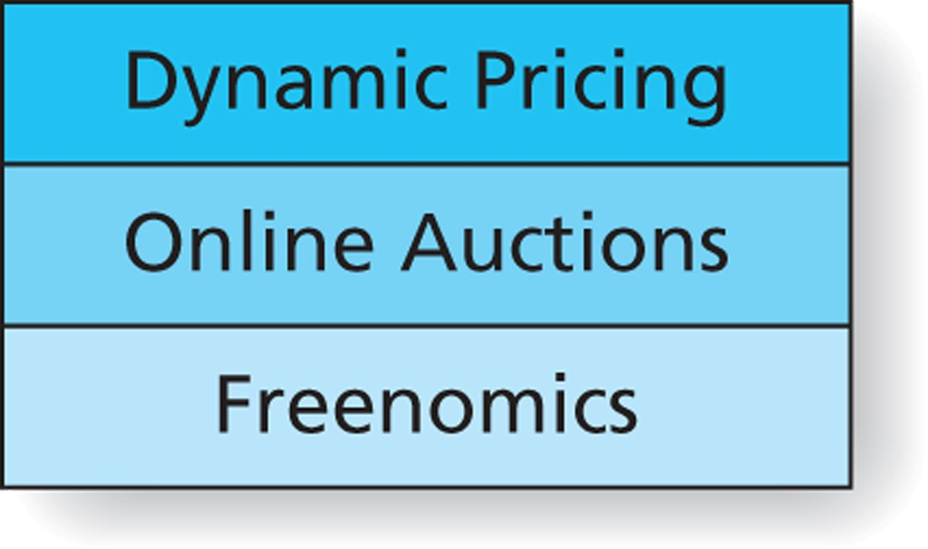

Figure 9.14
Internet Pricing Strategies
Ticketmaster and Dynamic Pricing
Visit skoreit.com
Visit Wired.com
Copyright © 2013 Pearson Canada Inc.
9-<number>
Notes:
This slide relates to LO #5 of chapter 9.
p. 331
LECTURE NOTES:
Technology available via ecommerce and the Internet in particular makes it easy for pricing to change quickly.
Dynamic pricing strategies are those in which the Internet seller can easily adjust the price to meet changes in the marketplace. The cost of changing prices on the Internet is practically zero, and firms can respond quickly and frequently to changes in costs, supply, and/or demand.
Some people refer to dynamic pricing as ‘real-time pricing’. For example, electricity prices might change as often as hourly and occasionally even more often based on the time of day and time of year. Another example of dynamic pricing can be found in the mortgage industry, where mortgage interest rates also vary to meet changes in the marketplace.
The link provided leads to a recent article discussing Ticketmaster’s plans to implement dynamic pricing in an effort to thwart scalpers.
Online auctions are familiar to most consumers and allows shoppers to purchase products through online bidding. B2B auction sites also exist. Skoreit.com is one of the newer bid sites targeting consumers. While the site is promoted as making it possible to purchase items for as much as 99% off of retail, the site itself requires users to purchase “bidpaks”, beginning as low as $9.90 Each bidpack contains a limited number of bids which can be used during auctions. The cost of each bid in early 2011 was around 60 cents each.
Freenomics is a business model based on the idea of externalities, which encourages giving products away for free because of the increase in profits that can be achieved by getting more people to participate in a market. So, the more people who sign up for Google’s Gmail, the more people are exposed to banner ads, which in turn increases the advertising rate and revenues. Freenomics was popularized in 2008 by an article written by Chris Anderson entitled, “Free! Why $0.00 is the future of business” (Wired, March 16, 2008); the link on this slide goes directly to the article and accompanying video.
The Internet also creates unique pricing challenges for marketers because consumers and business customers are gaining greater control over the buying process via “shopbots” and search engines. These tools, along with information provided by online reviews, create more advantages for shoppers.
WEB SITE NOTE:
Instructors can also access a 3-minute video on the Wired website (in about the middle of the article), which discusses the freenomics business model. However, the video is prefaced by a 30-second ad.
Instead of viewing the video on this Web page, instructors may wish to assign this article as an outside of class reading, then use the “scenario” predictions embedded within the article to generate discussion related to the feasibility of these predictions.

Slide 48
VI. Describe the legal and ethical aspects of pricing
Copyright © 2013 Pearson Canada Inc.
9-<number>
Notes:
This slide relates to LO #6 of chapter 9.

Slide 49
Legal and Ethical Aspects of Pricing
Deceptive pricing practices
    The Competition Act specifies that sellers cannot make a representation to the public that is false or misleading in a material respect
Bait and switch is one form of deceptive pricing practice
    Bait and switch: An illegal marketing practice in which an advertised price special is used as bait to get customers into the store with the intention of switching them to a higher-priced item
Copyright © 2013 Pearson Canada Inc.
9-<number>
Notes:
This slide relates to LO #6 of chapter 9.
p. 333

Slide 50
Legal and Ethical Aspects of Pricing (ctn’d)
Predatory pricing
    The strategy of selling products at unreasonably low prices to drive competitors out of business, then raising prices to earn higher profits
    This is a criminal offence under the Competition Act
    However, a low price is not necessarily a predatory price
      Loss-leader pricing is a legal strategy
Copyright © 2013 Pearson Canada Inc.
9-<number>
Notes:
This slide relates to LO #6 of chapter 9.
p. 333 - 334

Slide 51
Legal and Ethical Aspects of Pricing (ctn’d)
Price discrimination
    The illegal practice of offering the same product of like quality and quantity to different business customers at different prices, thus lessening competition
    A criminal offence under the Competition Act
    It only applies to the sale of goods, not leases, licenses, or the consignment of goods or the sale of services
    It only applies to business purchasers, not end users or consumers
    It doe not apply to concessions (e.g., discounts, rebates)
Copyright © 2013 Pearson Canada Inc.
9-<number>
Notes:
This slide relates to LO #6 of chapter 9.
p. 334

Slide 52
Legal and Ethical Aspects of Pricing (ctn’d)
Price maintenance (fixing)
    The collaboration of two or more firms in setting prices, usually to keep prices high
    A criminal offence under the Competition Act
  Horizontal price fixing
    Collusion between competitors making the same product
  Vertical price fixing
    Collusion between a manufacturer and a retailer, or a wholesaler and a retailer
  Bid rigging
    Collusion between suppliers responding to bid requests to lessen competition and secure higher margins
Copyright © 2013 Pearson Canada Inc.
9-<number>
Notes:
This slide relates to LO #6 of chapter 9.
p. 334 - 335

Slide 53

All rights reserved. No part of this publication may be reproduced, stored in a retrieval system, or transmitted, in any form or by any means, electronic, mechanical, photocopying, recording, or otherwise, without the prior written permission of the publisher. Printed in Canada.
Copyright © 2013 Pearson Canada Inc.
9-<number>

